Slide 1
Land and Forests
Dr. V.S. Ramachandran
Centre for Environmental Studies

Slide 2
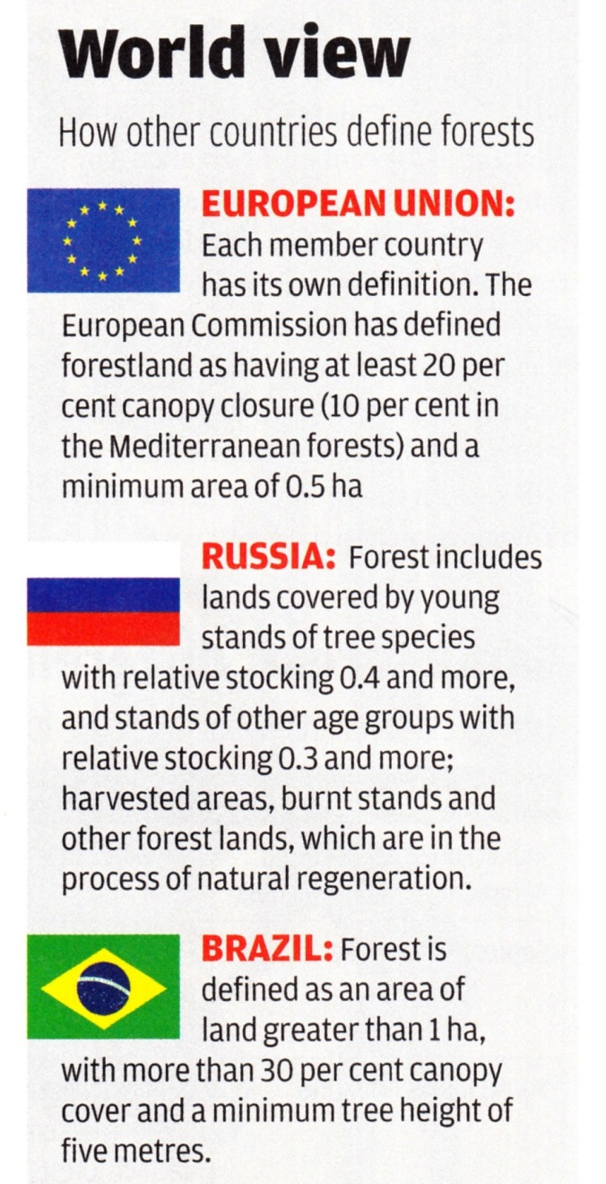
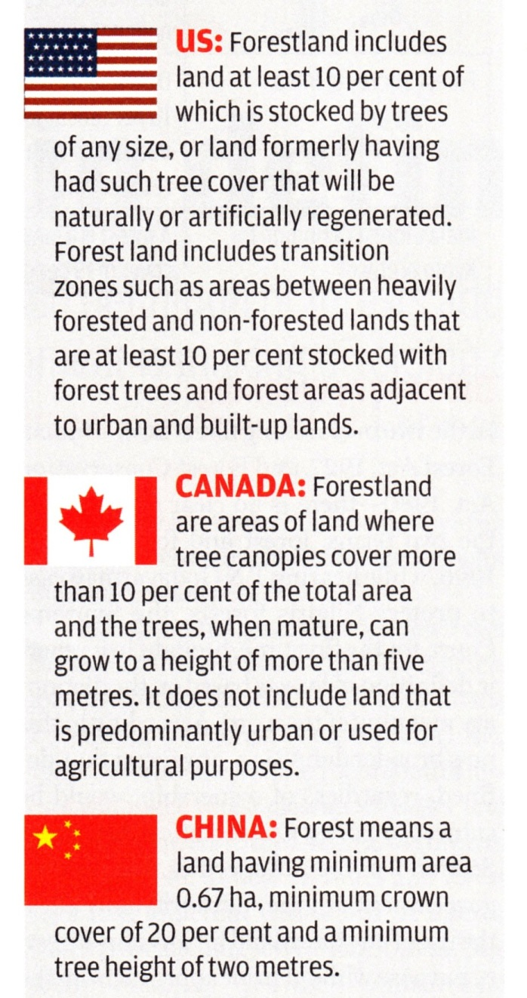
What is a forest?

Slide 3
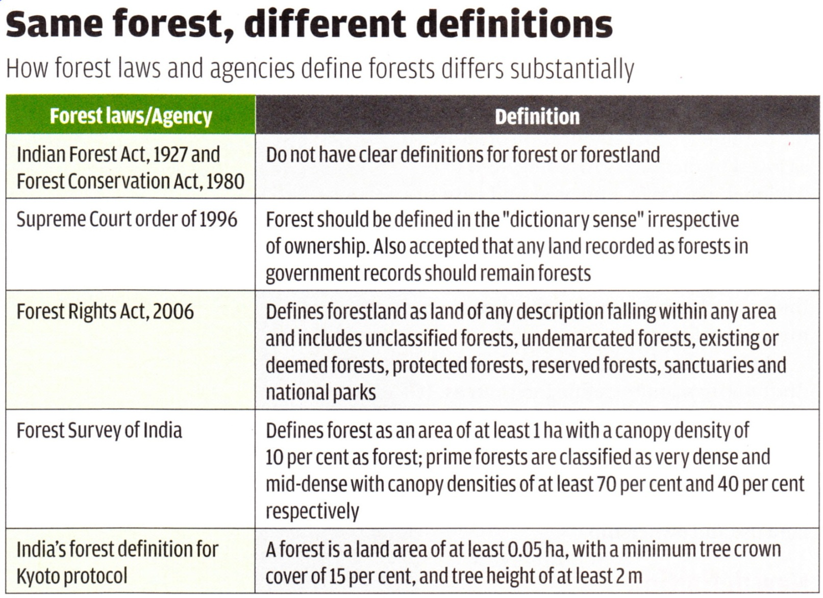
What is a forest?
Chakravarthy, A. 2016. Lost in definition. Down to Earth, 25 (6): 16-18.

Slide 4
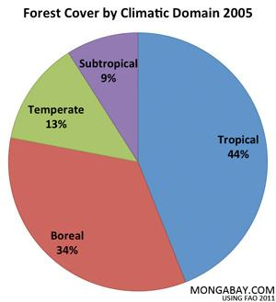
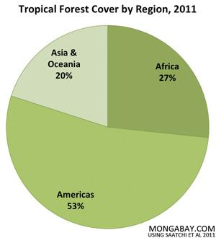
Forest Resources

Slide 5
Forest Resources
Tropical Forests
Seen as a belt around the globe up to 23⁰ on either side of the equator
They grow in areas receiving annual rainfall >2000 mm or above & with a short dry period (4-5 months)
Trees reach a height of 45-50

Slide 6
Forest Resources
Sub-tropical Forest
Seen from 23⁰ to 45⁰ on either side of the equator
Winters are relatively warm
Frost or snow is rare

Slide 7
Forest Resources
Temperate Forest
seen from 45⁰ to 66⁰ on either side of the equator
Region experiences four season, with a well-defined winter
This contains broad leaved evergreens, deciduous & coniferous plants

Slide 8
Forest Resources
Boreal forests
Forested areas within the boreal zone
Made up of cold-hardy trees
many of them coniferous (such as pine, spruce, larch & fir)
some deciduous (such as poplar & birch).

Slide 9
Forest Resources
Boreal forests
The boreal zone is the broad circumpolar vegetation zone of the high northern latitudes.
Boreal zone is more than just forest
It contains lakes, rivers & wetlands, as well as naturally treeless terrain such as alpine areas, heathlands in regions where the climate is influenced by the ocean, & grasslands in drier areas

Slide 10
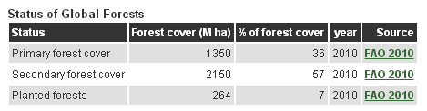
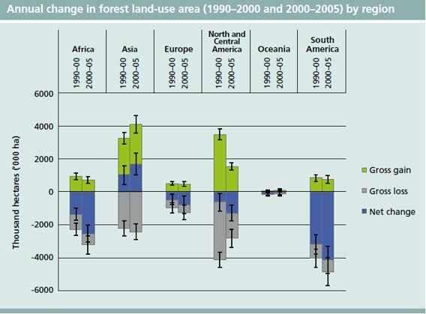
Status of Forest Resources

Slide 11
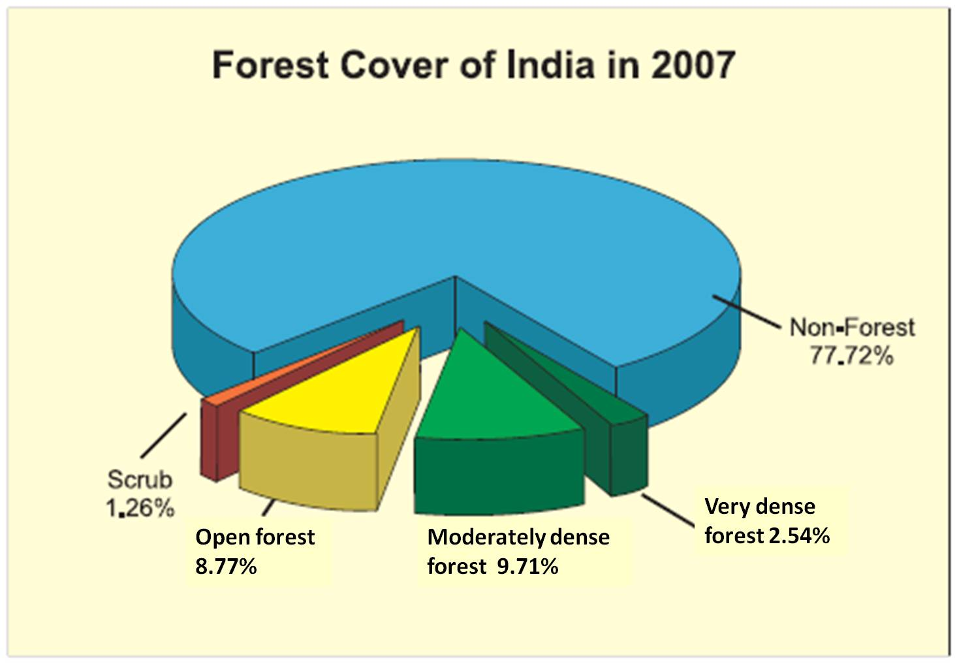
India’s forest cover

Slide 12
Role of forest/vegetation
Helps in sequestration/trapping of CO₂
For one ton of wood produced 1.8 tons of CO₂ is removed & 1.3 tons of O₂ is released
Reducing the intensity of rainfall & impact on soil
Leaf litter & other organic materials on forest floor slow down surface runoff & Provides nutrients & soil carbon (humus) to the soil

Slide 13
Role of forest/vegetation
Carbon-rich soil absorbs water like a sponge there by enhances retention & storage of water
More ground infiltration, better aquifer recharge, slow discharge to streams & better flow of water in rivers throughout the year
Tropical rainforests produce about 30% of our planet's fresh water

Slide 14
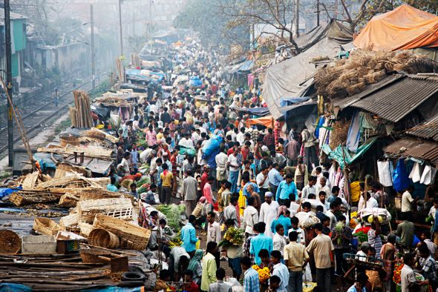
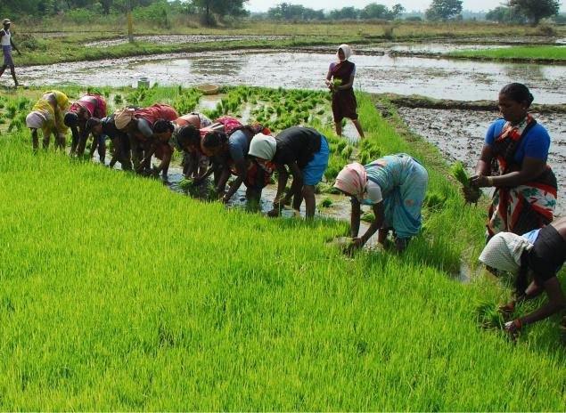
Deforestation/Habitat Destruction: WHY?
Setting up of human establishments
Conversion to agricultural lands

Slide 15
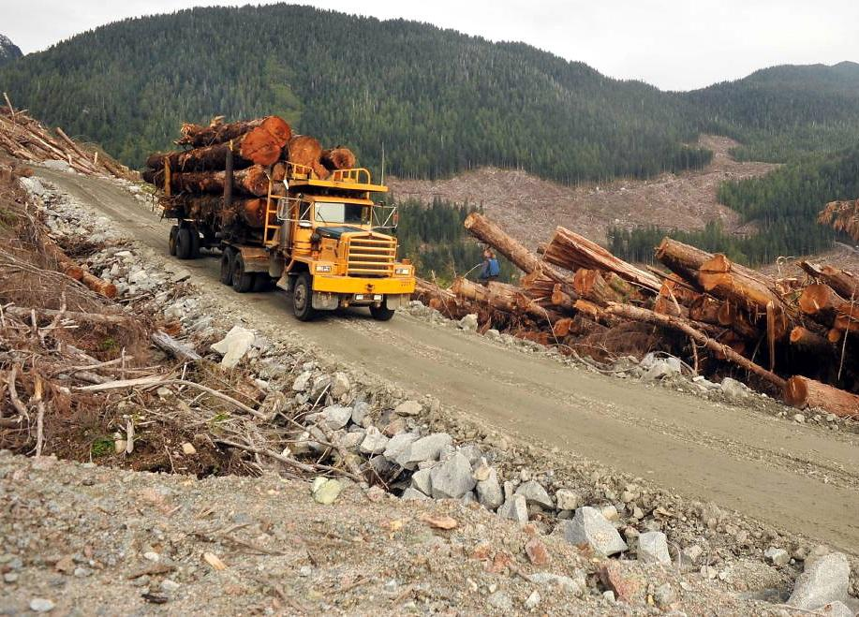
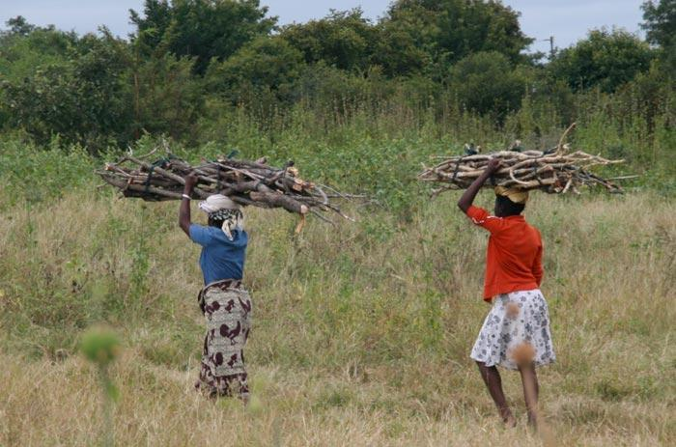
Deforestation/Habitat Destruction: WHY?
Logging or cutting tree for timber needs
Firewood collection

Slide 16
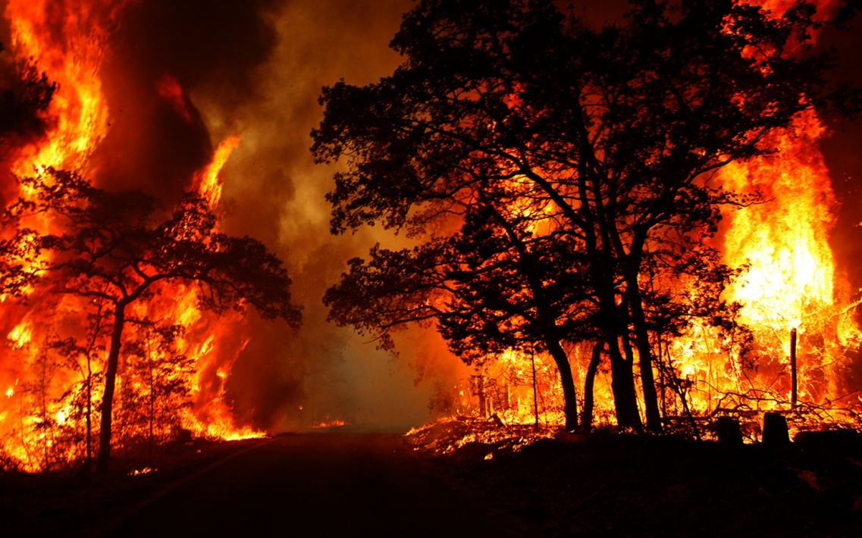
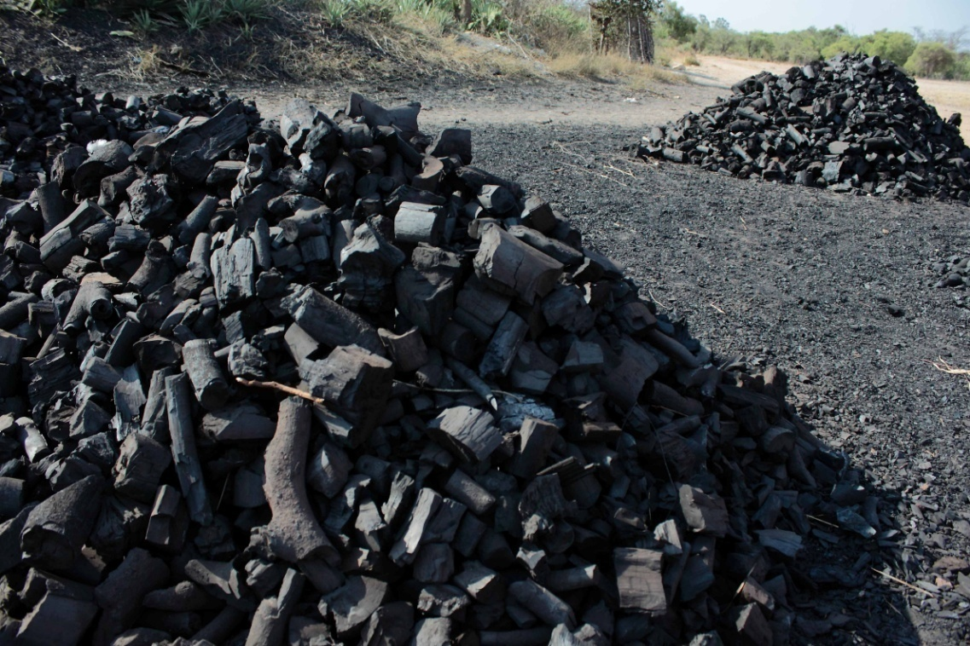
Deforestation/Habitat Destruction: WHY?
Fires in forest – human induced
Charcoal making

Slide 17
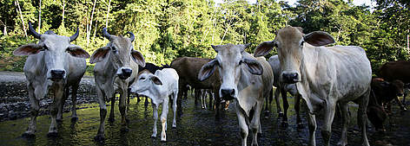
Deforestation/Habitat Destruction: WHY?
Cattle grazing in forest

Slide 18
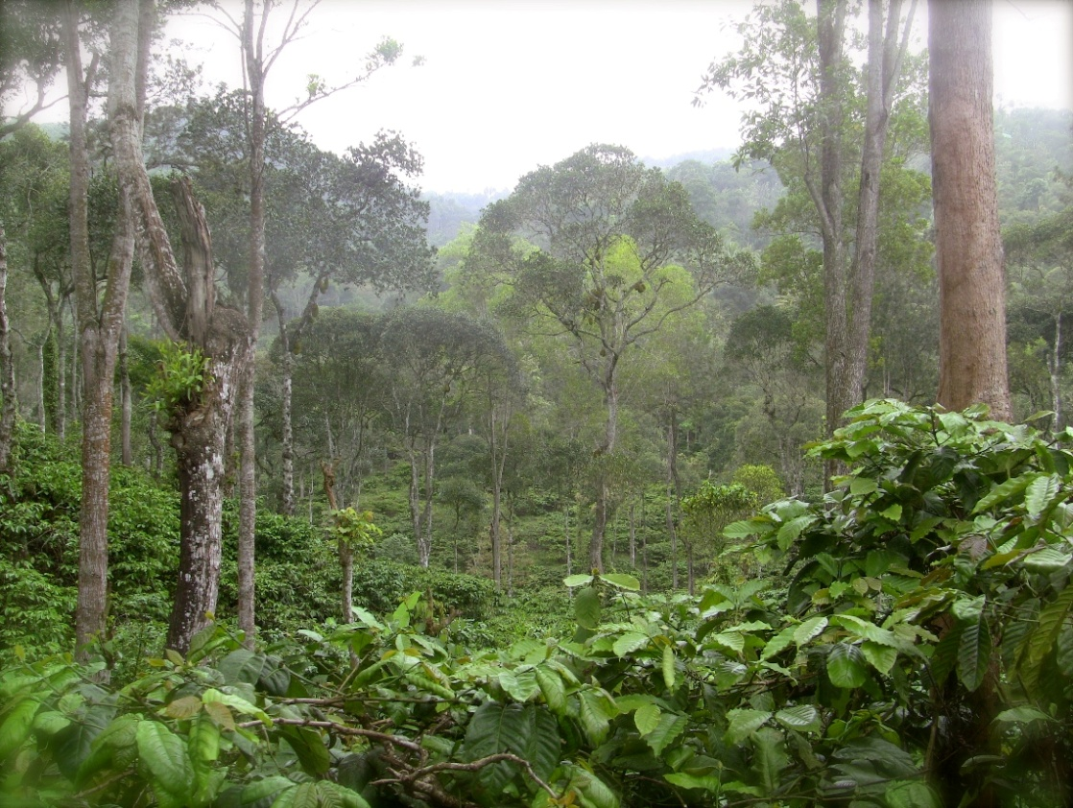
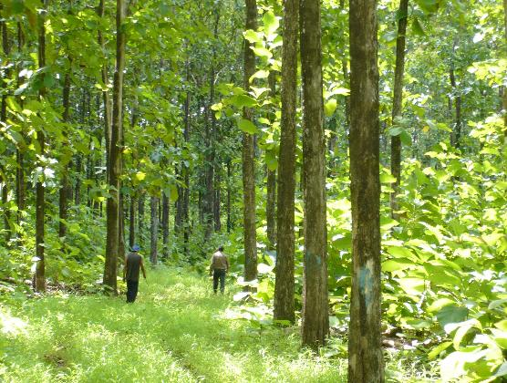
Deforestation/Habitat Destruction: WHY?
Establishment of cash crop plantation
Establishment of timber plantation

Slide 19
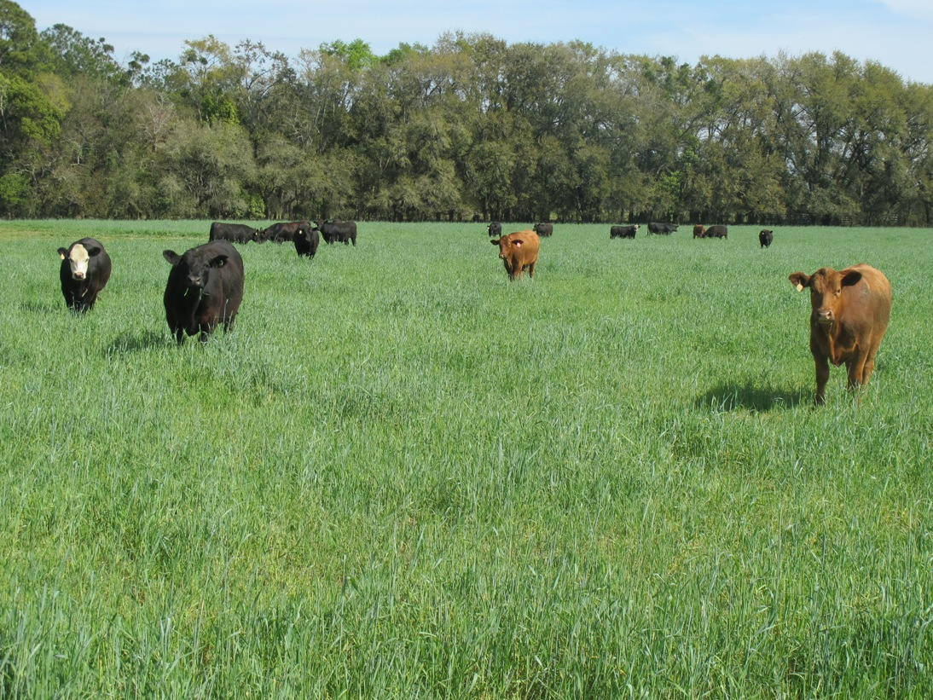
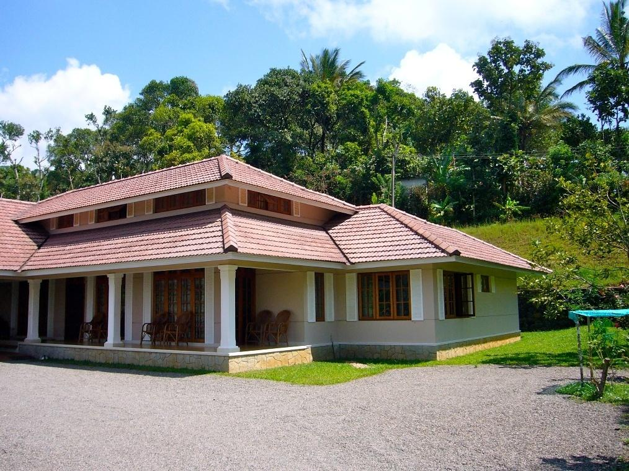
Deforestation/Habitat Destruction: WHY?
Establishment of ranches
Building homes

Slide 20
Deforestation/Habitat Destruction
Between 2000 & 2010 estimated deforestation was 13 mi ha per year
Most deforestation taking place in tropical countries
In 2010, forests covered about 31 % of world’s total land area – about 4.033 mi ha
corresponds to an average of 0.6 ha per capita

Slide 21
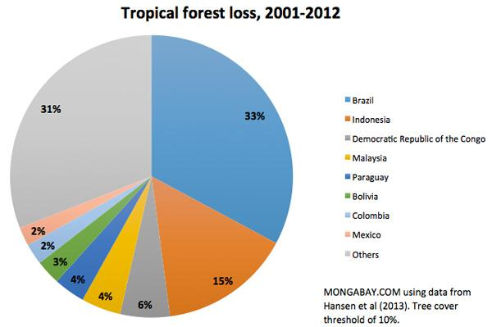
Deforestation/Habitat Destruction

Slide 22
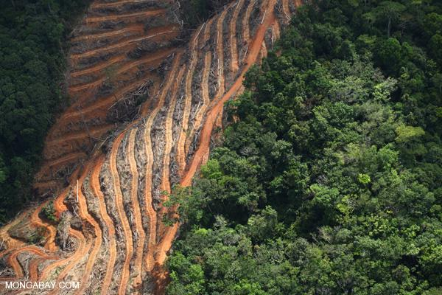
Deforestation/Habitat Destruction: WHY?
48%: Subsistence farming
32%: Commercial agriculture
14%: Logging for timber & soft wood
5%: Fuel wood & Charcoal
UNFCC 2017
Aerial view of deforestation taking place in Indonesia, where forest is getting replaced with oil palm plantation

Slide 23
Status of forest
Between 1990 & 2010
amount of forest land designated primarily for the conservation of biological diversity increased by 35%
These forests now account for 12% of the world’s forests

Slide 24
Deforestation/Habitat Destruction: WHY?
Impact of deforestation
Loss of biodiversity
Reduced sequestration of atmospheric CO₂
Adverse soil erosion
Disruption of H₂O cycle
Most often deforested land degrade into wasteland
Flood & drought
Enhances impact of climate change

Slide 25
Land Degradation
Land degradation is the reduction in capacity of the land to provide ecosystem goods & services, & assure its functions over a period of time
Land degradation affects large areas & especially many people in dry land regions
About 2000 million ha of soil, equivalent to 15% of the Earth's land area have been degraded through human activities

Slide 26
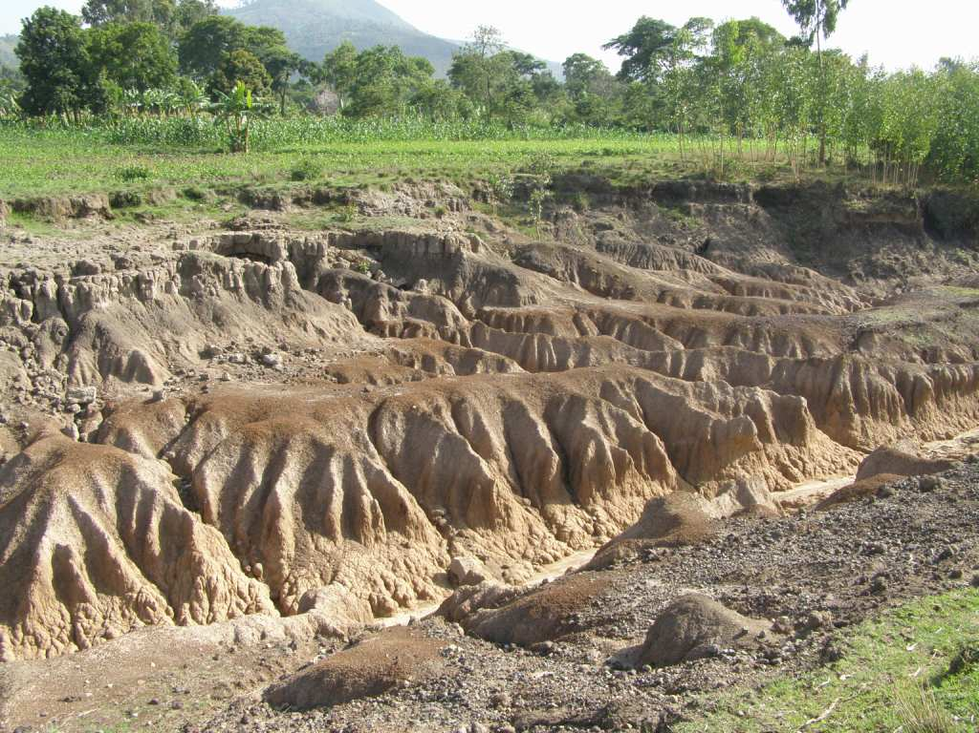
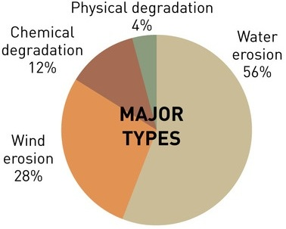
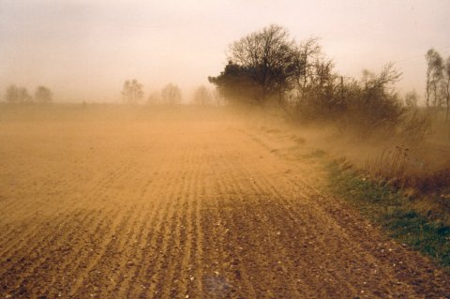
Land Degradation

Slide 27
Land Degradation
Soil erosion is a major factor in land degradation & has severe effects on soil functions - such as
Soil's ability to act as a buffer & filter for pollutants
Its role in the hydrological & nitrogen cycle
Its ability to provide habitat & support biodiversity

Slide 28
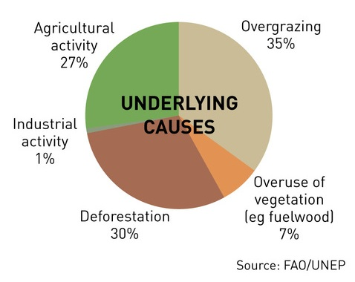
Land Degradation

Slide 29
Land Degradation
Agricultural activity leading to land degradation:
Unsustainable agricultural land use
Poor soil & water management
Frequent use of heavy machinery
Improper crop rotation
Natural disasters, including drought, floods & landslides

Slide 30
Land Degradation
About 24% of global land area has been affected by land degradation
area is equivalent to the annual loss of about 1% of global land area, which could produce 20 million tons of grain each year
or 1%of global annual grain production
World Watch Institute, 2017.

Slide 31
Land Degradation
Areas undergoing degradation
Cultivated land: 20%
Forest: 30%
Grass lands: 10%
An estimated 1.5 billion people, or ¼ of the world’s population, depend directly on land that is being degraded
FAO Newsroom. 2008

Slide 32
Deforestation & Land Degradation
Land Degradation
Areas undergoing degradation
Among the degrading land
22% is very arid to dry sub-humid areas
78% is in humid regions
Degradation is being driven mainly by poor land management
FAO Newsroom. 2008

Slide 33
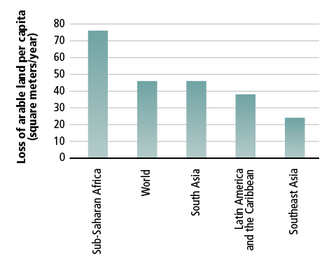
Deforestation & Land Degradation
Land Degradation

Slide 34
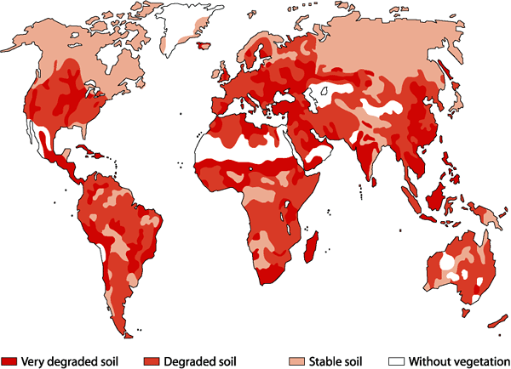
Deforestation & Land Degradation
Land Degradation

Slide 35
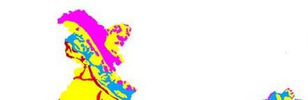
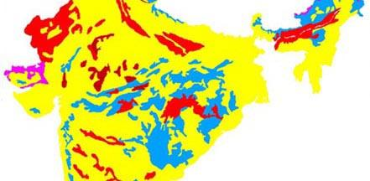
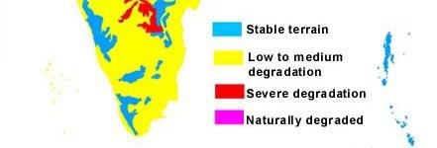
Deforestation & Land Degradation
Land Degradation

Slide 36
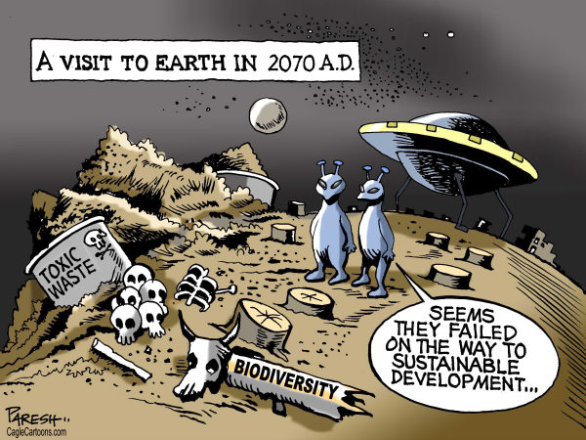
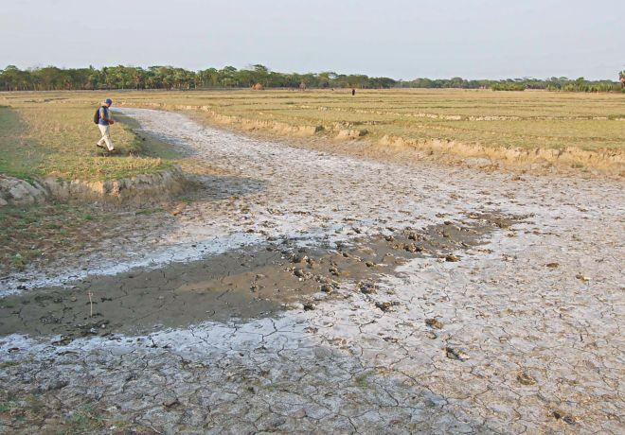
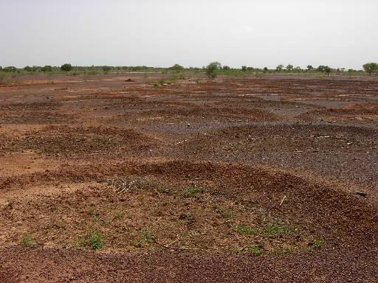
Land Degradation: IMPACTS!!
Loss of biodiversity
Salinization
Loss of fertility/productivity

Slide 37
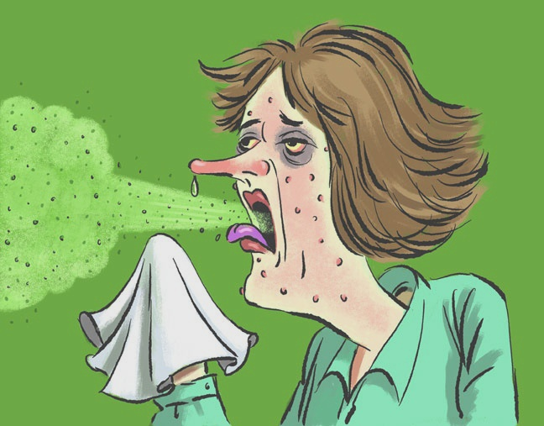
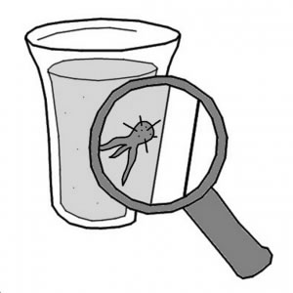
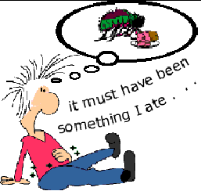
Land Degradation : IMPACTS!!
Airborne diseases
Waterborne diseases
Foodborne diseases

Slide 38
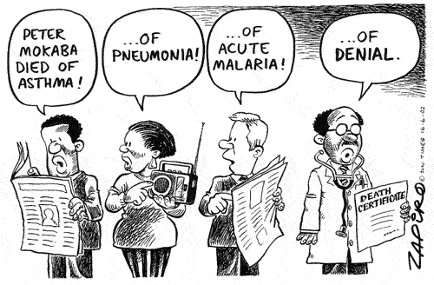
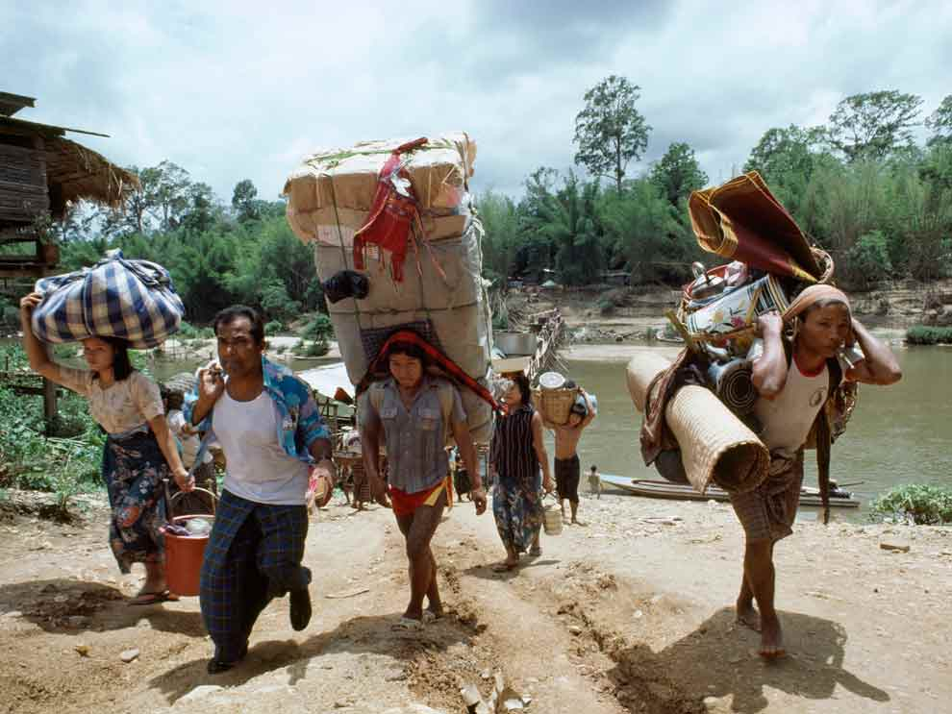
Land Degradation : IMPACTS!!
Spread of communicable diseases
Forced migration of people

Slide 39
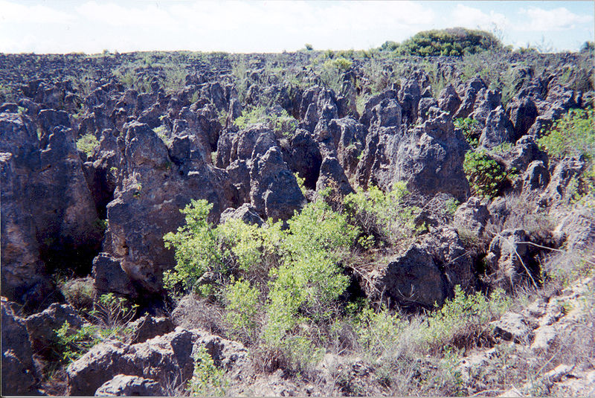
Land Degradation: IMPACTS
Serious land degradation in Nauru after the depletion of the phosphate cover through mining

Slide 40
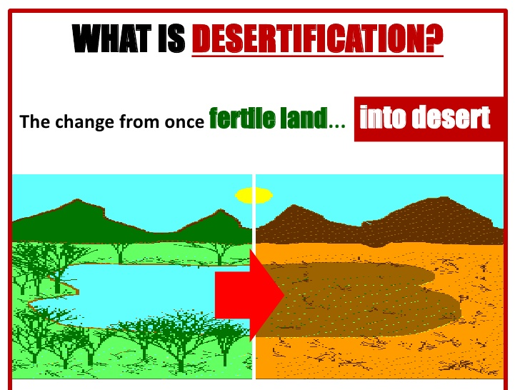
Desertification
Land degradation in arid, semi-arid (average annual rainfall less than 600 mm) & sub-humid areas is called desertification
When land degradation happens in the world’s drylands, it often creates desert-like conditions

Slide 41
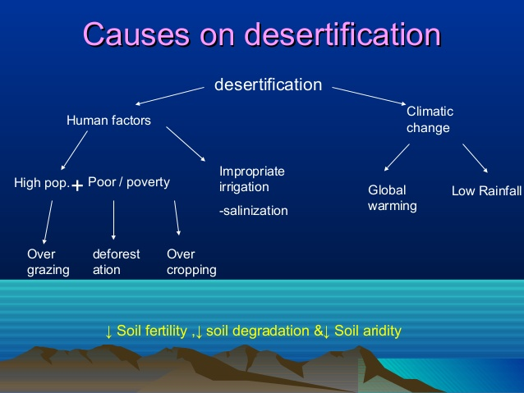

Slide 42
Causes of desertification
Cultivation on marginal lands
Marginal Land
Arid and generally unhospitable land
often has poor soil or other undesirable characteristics
Thus has high risk of crop failure
usually has little or no potential for profit
This land is often located at the edge of deserts or other desolate areas
Read more: Marginal Land Definition | Investopedia http://www.investopedia.com/terms/m/marginal-land.asp#ixzz4O4mu1QJi

Slide 43
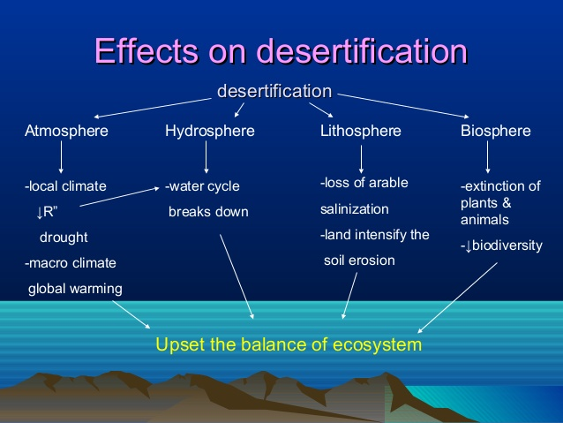

Slide 44
Effects of desertification
Reduction in ability of land to support life, affecting
wild species,
domestic animals
agricultural crops
people
Reduction in plant cover leading to accelerated soil erosion by wind & water
South Africa losing approximately 300-400 million tonnes of topsoil every year

Slide 45
Effects of desertification
As vegetation cover and soil layer are reduced,
rain drop impact & run-off increases
percolation decreases

Slide 46
How widespread is desertification?
About 1/3rd of world's land surface is arid or semi-arid.
Global warming will increase area of desert climates by 17% in the next century
Worldwide, desertification is making approximately 12 mi ha useless for cultivation every year

Slide 47
Areas prone to desertification
About ½ of southern Africa is semi-arid & thus at risk of desertification
The areas which are known to have deteriorated this century are mainly on the edges of the southern Kalahari

Slide 48
How can desertification be halted or prevented?
Reduce grazing pressure by reducing number of animals thus allowing plants to regrow
Protecting the vegetative cover
that protect top soil from wind & water erosion
Integrating land & water management to protect soils from degradation

Slide 49
How can desertification be halted or prevented?
Turning to alternative livelihoods like greenhouse agriculture & tourism-related activities
Creating economic opportunities in dry land urban centers & in areas outside of drylands

Slide 50
How can we restore or rehabilitate the ecosystem?
Preventing soil erosion by
Sand fences, stone fences, terracing
Making soil conditions favourable for plant growth by enriching with organic matter – mulching
Mulch (a layer of straw, leaves or sawdust covering the soil) reduces evaporation, suppresses weed growth, enriches soil as it rots, and prevents runoff & hence erosion

Slide 51
How can we restore or rehabilitate the ecosystem?
Creating green wall/tree wall
Planting trees
Establishing seed banks - Reseeding in badly degraded areas
Reintroducing native species of the area

Slide 52
How can we restore or rehabilitate the ecosystem?
Watershed management
Percolation tanks, contour bunding, check dams
Water harvesting using locally available/adapted techniques & storage
Cooking Fuel: Planting trees for firewood

Slide 53


